Slide 1
Sustainable & Smart Tourism
Training Program
Organized by Mekong Institute (MI)
Funded by Mekong – Korea Cooperation Fund (MKCF)
November 2023

Slide 2
Smart Tourism & Sustainability
MODULE 5
Trainer
November 2023

Slide 3
Benefits from Smart Tourism to Communities, Companies, and Visitors
Session 2
Monday

Slide 4
Practical Benefits from Smart Tourism
Enhancing Community Well-Being
Designing Unique Visitor Experiences

Slide 5
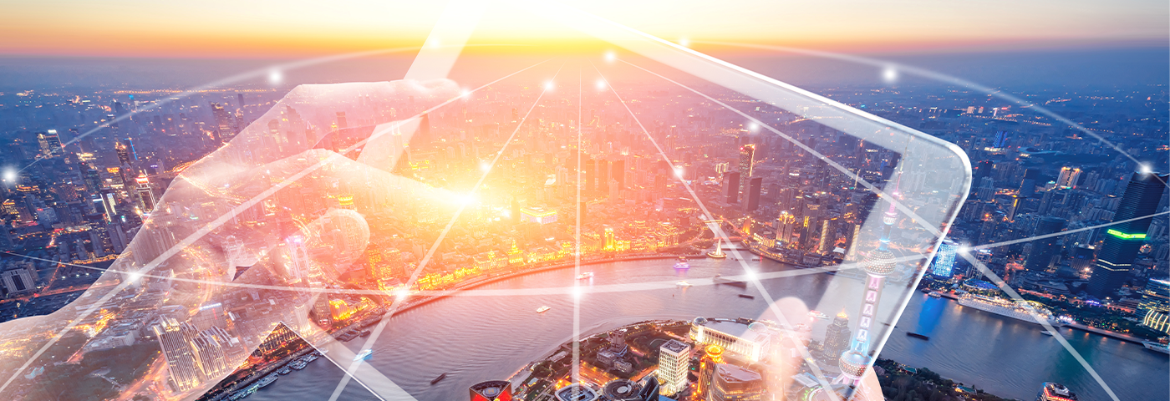
Practical Benefits from Smart Tourism
Smart tourism will have a significant impact on the pace of transformation and the extent to which positive social, economic and environmental benefits will be able to scale (WEF, 2019). Facilitating the adoption of new technologies in tourism SMEs, empowering tourism SMEs to keep pace with evolving consumer demands, and supporting the digitalisation of marketing channels and business models and processes in tourism SMEs are important priorities for the sector.

Slide 6
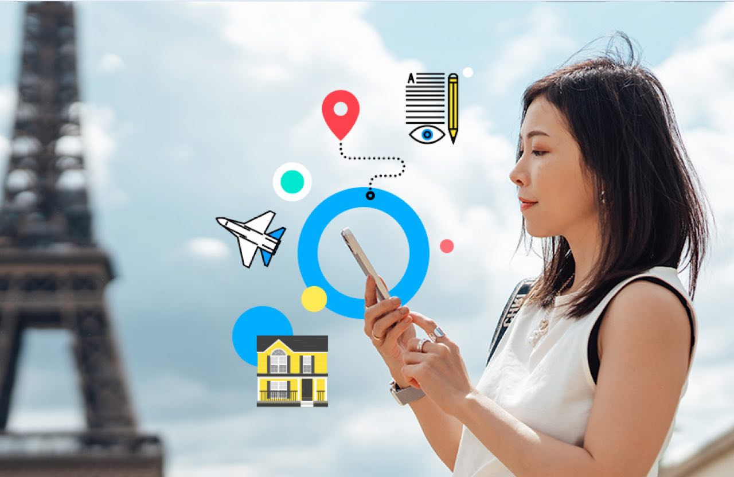
Practical Benefits from Smart Tourism
Considering business opportunities, digitalisation inspires innovative models, solutions and ecosystems. It opens up new roles for consumers and producers, making way for start-ups and upscaling existing businesses. While also helping meet supply and demand. Given that SMEs and micro enterprises make up the bulk of the business contribution to tourism the benefits of adopting smart technological applications are obvious.

Slide 7
Practical Benefits from Smart Tourism
Considering business opportunities, digitalisation inspires innovative models, solutions and ecosystems. It opens up new roles for consumers and producers, making way for start-ups and upscaling existing businesses. While also helping meet supply and demand. Given that SMEs and micro enterprises make up the bulk of the business contribution to tourism the benefits of adopting smart technological applications are obvious.

Slide 8
Practical Benefits from Smart Tourism
Some common benefits for companies are
1. Increased Revenue: Smart tourism can attract more tourists and encourage them to spend more, leading to increased revenue for businesses, including hotels, restaurants, and tour operators.
2. Data-Driven Insights: Companies can gather valuable data about customer preferences, behaviors, and trends, enabling them to tailor their services, marketing, and pricing strategies.
3. Operational Efficiency: Automation and technology can streamline operations, reduce costs, and improve customer service, ultimately enhancing profitability.

Slide 9
Practical Benefits from Smart Tourism
Some common benefits for companies are
4. Marketing Opportunities: Smart tourism provides new avenues for marketing and advertising, helping businesses to reach a wider audience and target their promotions effectively.
5. Competitive Advantage: Companies that embrace smart tourism early gain a competitive edge and can establish themselves as leaders in the industry.

Slide 10
Enhancing Community Well-Being
On a destination level the residents are able to benefit on various areas from smart tourism policies and implementation.
Economic Development: Smart tourism can stimulate economic growth in local communities by increasing visitor numbers and spending. This can lead to the creation of jobs and the development of small businesses, such as local restaurants and shops.
Preservation of Culture: By promoting sustainable tourism practices, smart tourism can help preserve the cultural and historical heritage of a destination, ensuring that communities can maintain their traditions and way of life.

Slide 11
Enhancing Community Well-Being
On a destination level the residents are able to benefit on various areas from smart tourism policies and implementation.
3. Infrastructure Improvement: Increased tourism revenue can lead to investments in infrastructure, including transportation and public services, benefiting both residents and visitors.
4. Safety and Security: The advanced technological developments and the digital application are creating tools that can be used to increase safety and security measures and improve conditions within the destination for the local residents .

Slide 12
Enhancing Community Well-Being
These and other benefits create a significant improvement to the quality of the daily life of the local communities. It is a matter of how the technological tools are used by governing authorities towards a more systematic integration of the digital tool for the services and the protection of the communities.
As a result, this improvement lead to much better conditions and actually to the well-being of the residents.

Slide 13
Designing Unique Visitors’ Experiences
Smart tourism is improving many areas of the tourism chain where the vistors use from the travel decision making process to their trip and to their experience at the destination.
Some of the most important benefits from them are:
1. Enhanced Travel Experience:
- Personalized Recommendations: Smart tourism technology can provide tailored recommendations for activities, dining, and accommodations based on a visitor's preferences and past behavior.
- Augmented Reality (AR) and Virtual Reality (VR): AR and VR applications can provide immersive experiences, allowing tourists to explore destinations virtually before or during their trips.

Slide 14
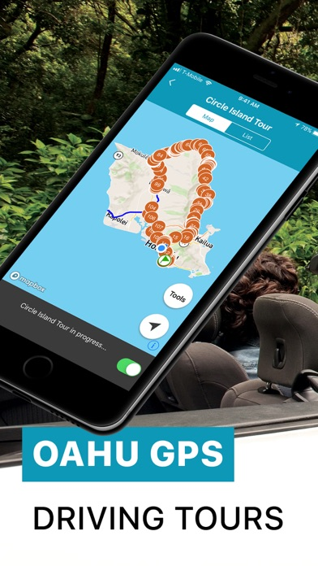
Designing Unique Visitors’ Experiences
2. Improved Accessibility:
- Navigation and Maps: Mobile apps and GPS navigation systems make it easier for tourists to find their way around unfamiliar destinations, reducing the risk of getting lost.
- Multilingual Support: Translation apps and services help overcome language barriers, making it easier to communicate and access local information.

Slide 15
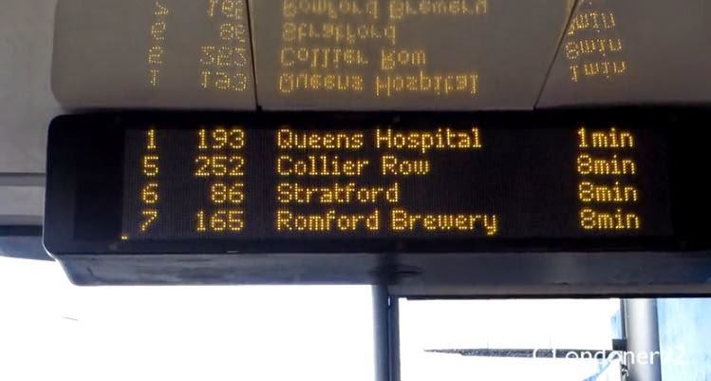
Designing Unique Visitors’ Experiences
3. Real-time Information:
- Live Updates: Smart technology provides real-time information on weather, traffic, and events, allowing tourists to adapt their plans and stay informed.
- Crowd Management: Apps and platforms can help tourists avoid overcrowded places and choose less crowded times to visit popular attractions.

Slide 16
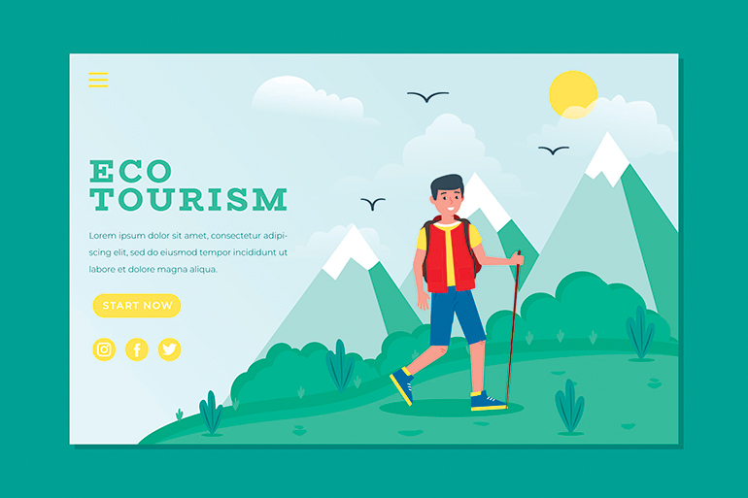
Designing Unique Visitors’ Experiences
4. Sustainable Tourism:
- Eco-friendly Travel: Technology can promote sustainable tourism practices, such as encouraging public transportation, reducing carbon footprints, and minimizing the environmental impact of tourism.
- Responsible Tourism: Apps and platforms can provide information on responsible travel options and eco-conscious accommodations and activities.

Slide 17
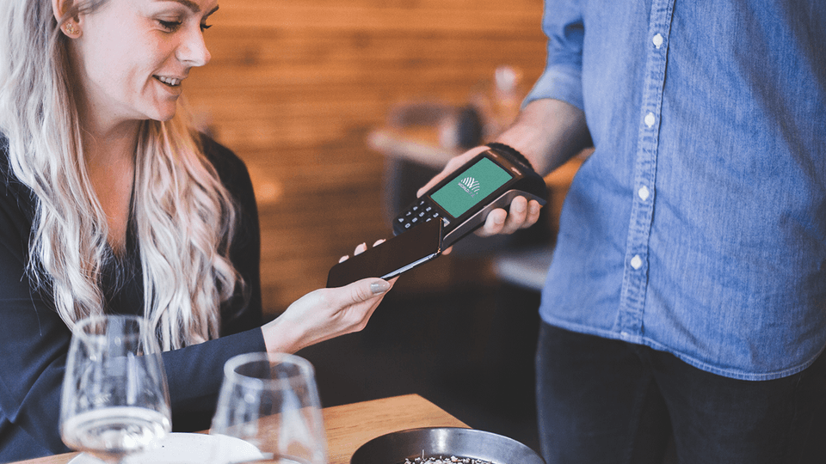
Designing Unique Visitors’ Experiences
5. Efficiency and Convenience:
- Mobile Payments: Mobile wallets and contactless payment options make it convenient for tourists to pay for goods and services without the need for local currency.
- Online Booking: Technology simplifies the booking process for flights, accommodations, tours, and activities, allowing tourists to plan their trips with ease.

Slide 18
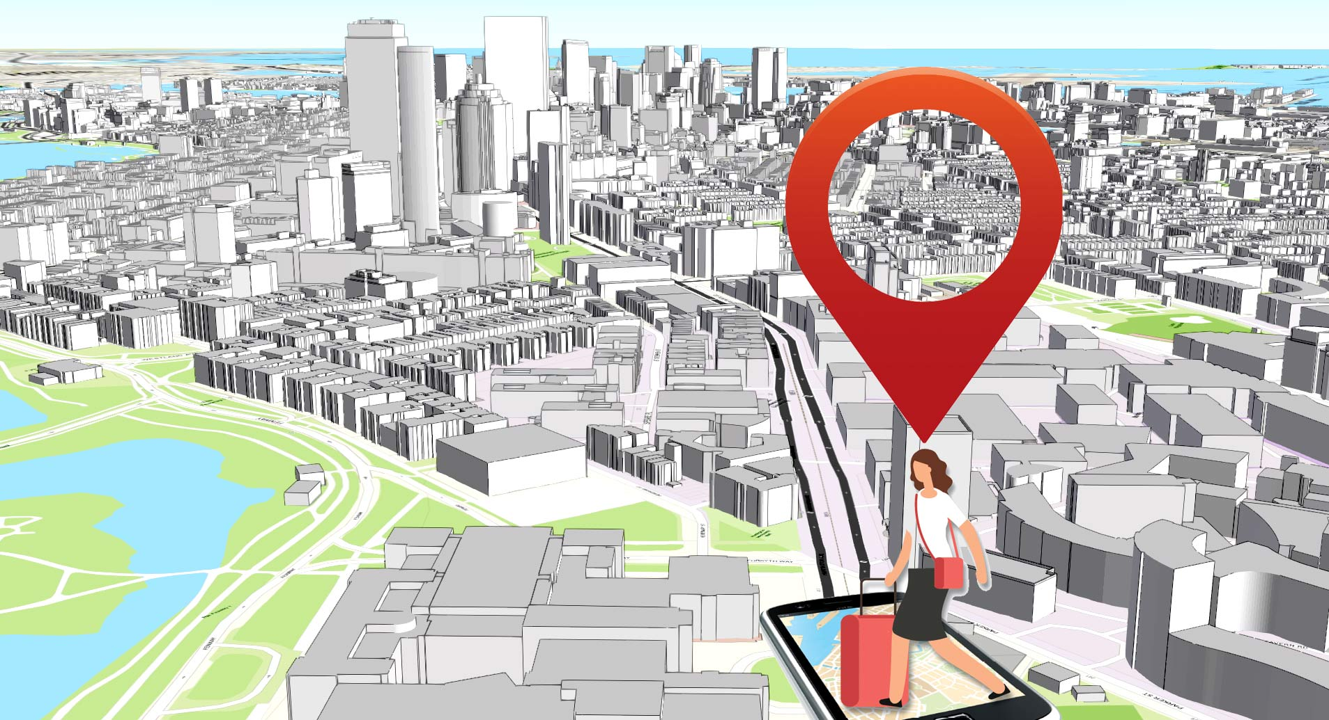
Designing Unique Visitors’ Experiences
6. Safety and Security:
- Emergency Services: Tourists can quickly access emergency services, local authorities, or medical assistance through mobile apps or smart devices.
- Location Sharing: Apps and wearables can enable tourists to share their location with family and friends for added safety.

Slide 19
Discussion about Benefits from Smart Tourism

Slide 20
Q & A Thank You!

